Slide 1
CHEST X-RAY COVID-19 IMAGE CLASSIFICATION WITH DEEP LEARNING

Slide 2
HELLO THERE!
I’M PRATYUSH PRASAD, AND I'LL BE SHARING WITH YOU MY VIEW POINTS. MY CONTACT DETAILS ARE
E-Mail – prasadpratyush2323@outlook.com
- pratyushprasad150101@gmail.com

Slide 3
AGENDA OF THE PROJECT
PROBLEM STATEMENT
DATA ANALYTICS
MODEL OF CHEST X-RAY ARCHITECTURE
RESULT AND OBSERVATIONS

Slide 4

THE PROBLEM
The virus called the severs acute respiratory syndrome, CoronaVirus-2 has been discovered in late 2019. the virus originated from China became cause of a disease known as Corona Virus Disease 2019 or COVID-19. The WHO declared this disease as a pandemic in March 2020.
This pandemic affected millions around the world. The most serious illness caused by COVID-19 is related to a lung disease such as pneumonia. The symptoms of this disease vary and include high fever, runny nose and cough.
In an early stage of the outbreak, due to lack of knowledge of the virus genome, the detection of disease was rudimentary.

Slide 5
THE SOLUTION
To solve this, Deep Learning (DL), a branch of Machine Learning (ML), is developed to detect hidden features in images which are not apparent or cannot be detected by medical experts.
With AI system aiding medical experts in expediting the diagnosis, earlier treatment can be prescribed, resulting in improves clinical outcomes.
Their advancements have massive applications specifically in medical data analytics, diagnosis through image processing and analysis. Neural networks (NN’s) are designed to process 2-D images. The model in question showcases -
Implementing AlexNet, ResNet-50, VGG-19, GoogleNet and ZfNet models, for training and predictions
Demonstrate Feature Engineering and Transfer Learning in API’s

Slide 6
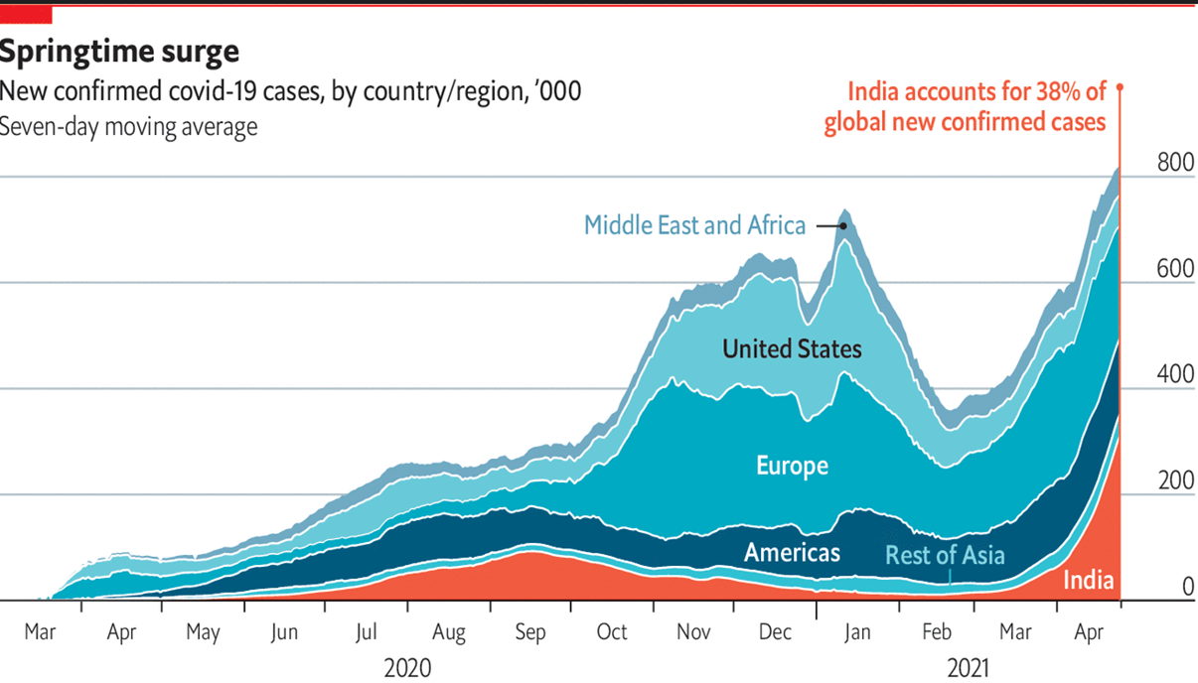
COVID-19 CASES AROUND THE WORLD
SOURCE JHON HOPKINS UNIVERSITY

Slide 7
STEPS INVOLVED IN THE PROJECT
STEP 1
OBTAINING THE
DATA
STEP 2
EXPLORING THE
DATASET
STEP 3
MAKING THE
MODEL
Name
Job Title
STEP 4
FITTING THE MODEL
WITH DATASET
STEP 5
EVALUATING THE
MODEL
STEP 6
RESULT ANALYSIS
STEP 4
MODEL TRAINING

Slide 8
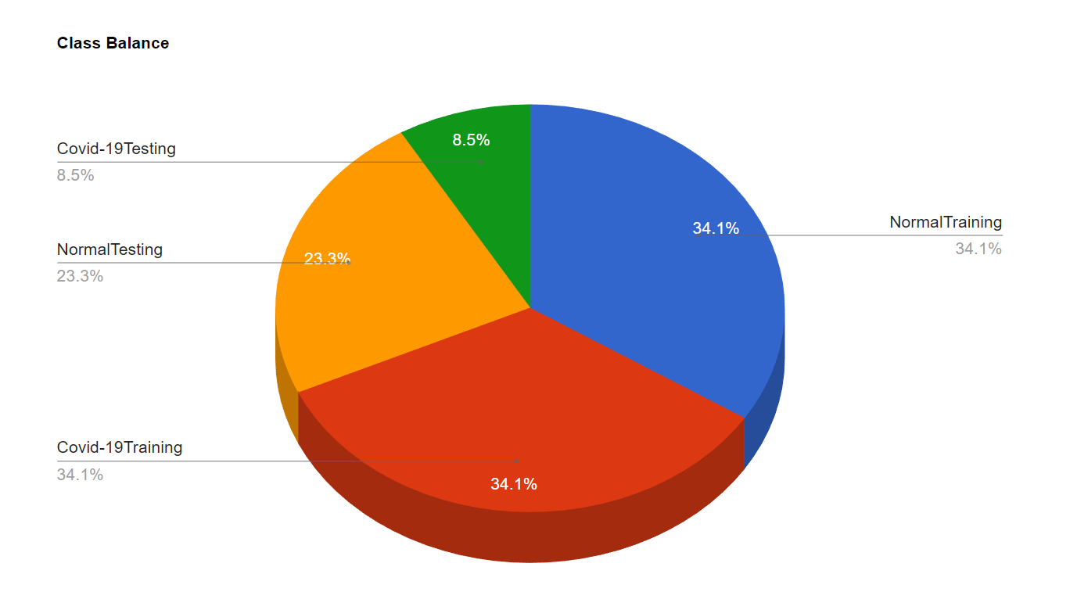
STEP 1
OBTAINING THE DATASET
The dataset has been obtained from Kaggle.com
The URL for the training dataset Page :-
https://www.kaggle.com/datasets/amanullahasraf/covid19-pneumonia-normal-chest-xray-pa-dataset
It contains 2313 Covid-19 Images and 2313 Normal Images for training
The URL for Testing dataset Page :-
https://www.kaggle.com/datasets/prashant268/chest-xray-covid19-pneumonia
It contains 576 Covid-19 images and 1583 Normal Images for testing

Slide 9
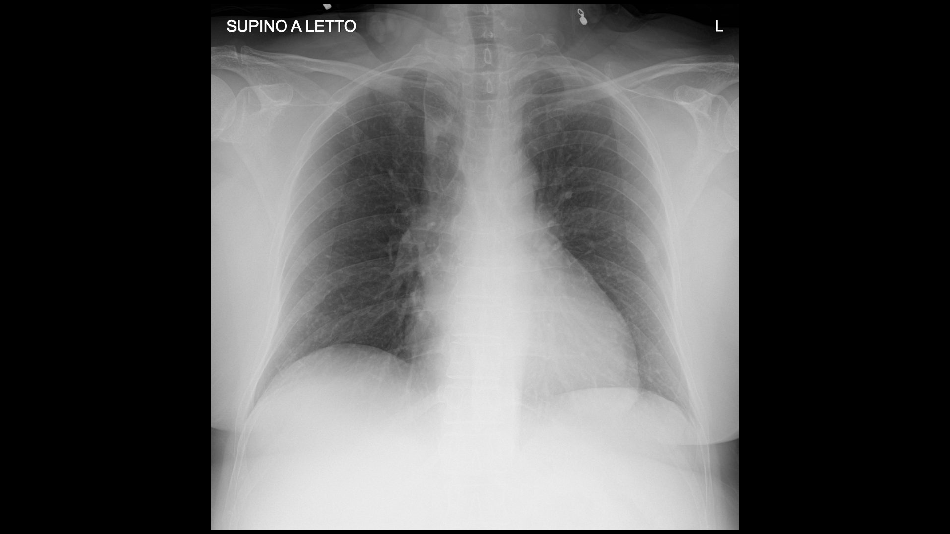
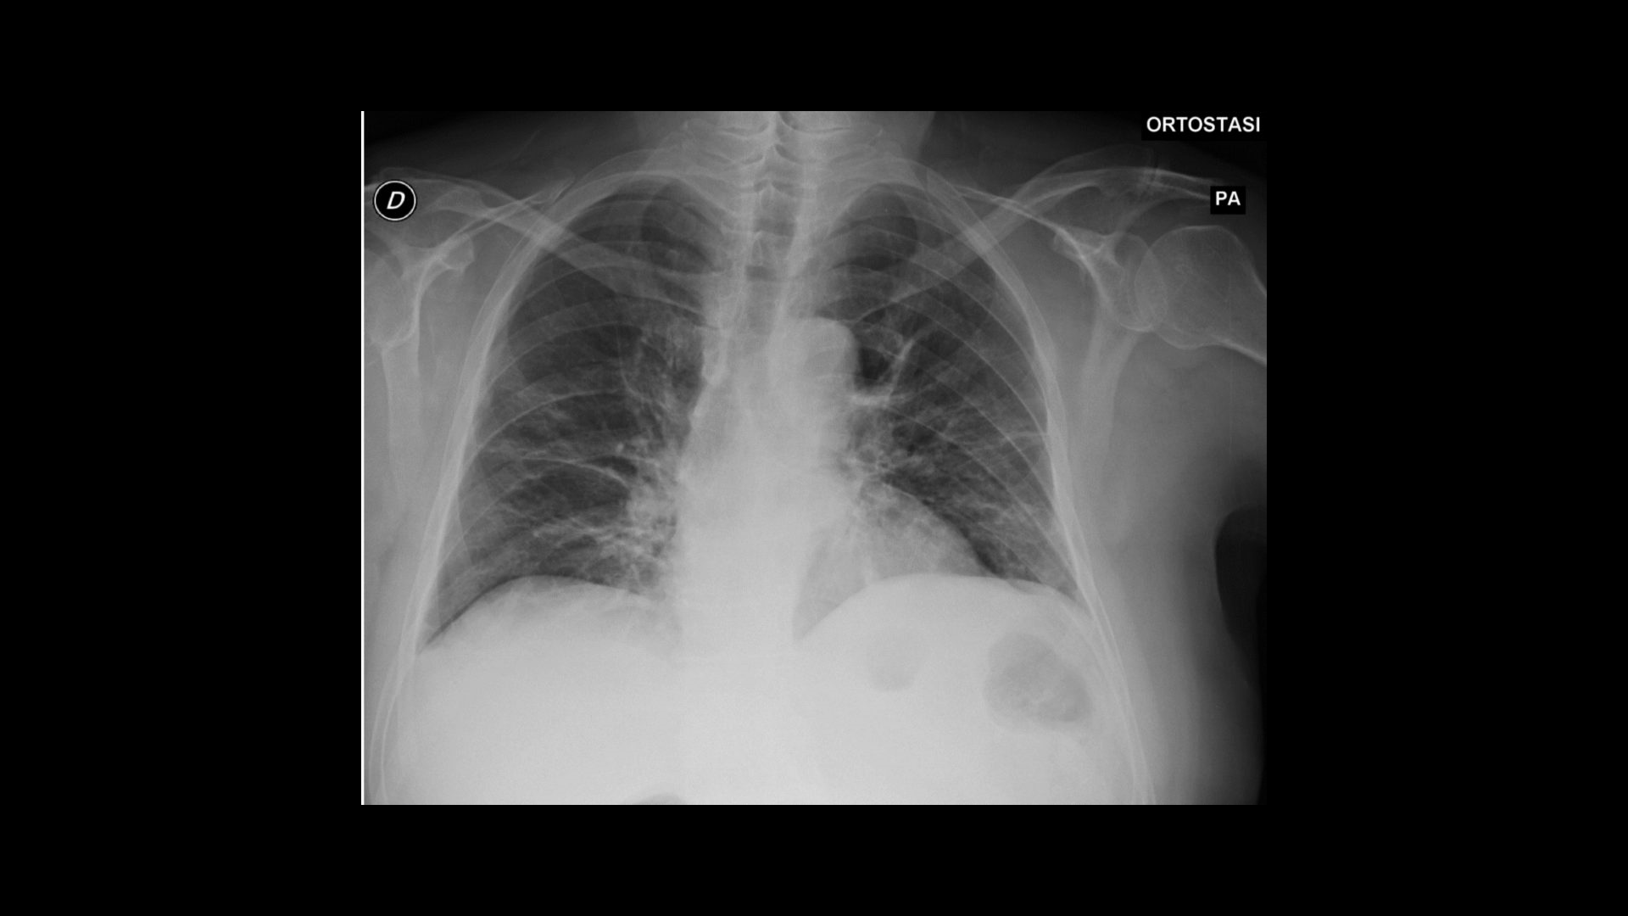
STEP 2
EXPLORING THE DATASET
DATA AUGMENTATION
To build a powerful image classifier using vary little training data, image augmentation is usually required to boost the performance of deep networks.
Image Augmentation artificially created training images through different ways of processing images, such as random rotation, shifts, shear and flips etc. of each training instances.

Slide 10
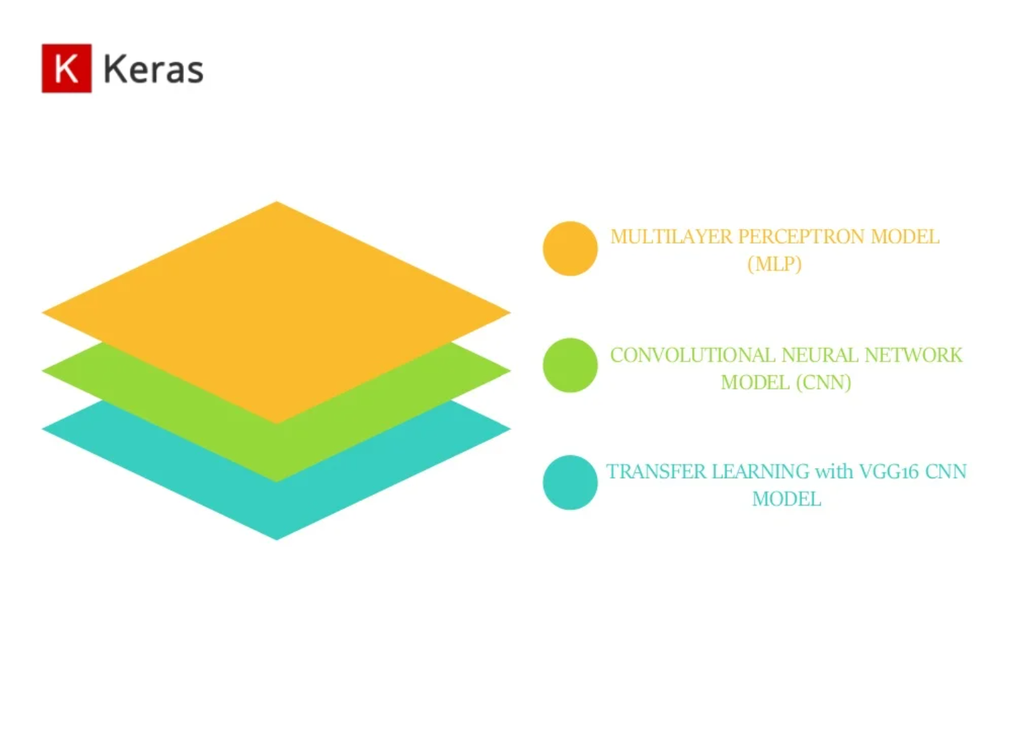

STEP 3
MAKING THE MODEL
Multi Layer Perceptron Model
Convolutional Neural Network Model
Transfer Learning with AlexNet, Vgg-19, GoogleNet, ResNet, Zf-Net CNN model

Slide 11
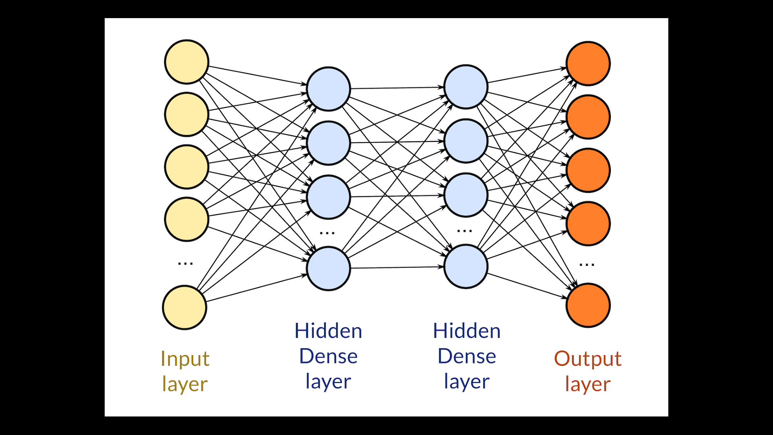
MULTI-LAYER PERCEPTRON

Slide 12
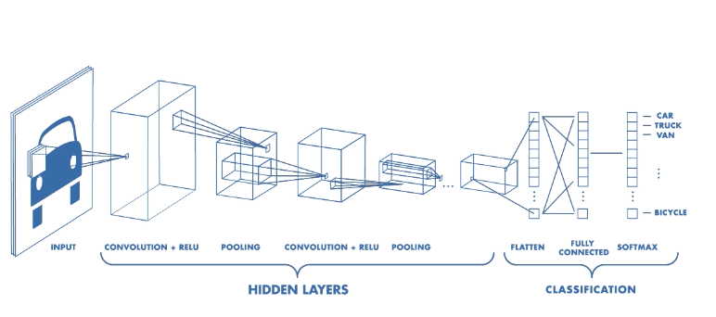

Slide 13
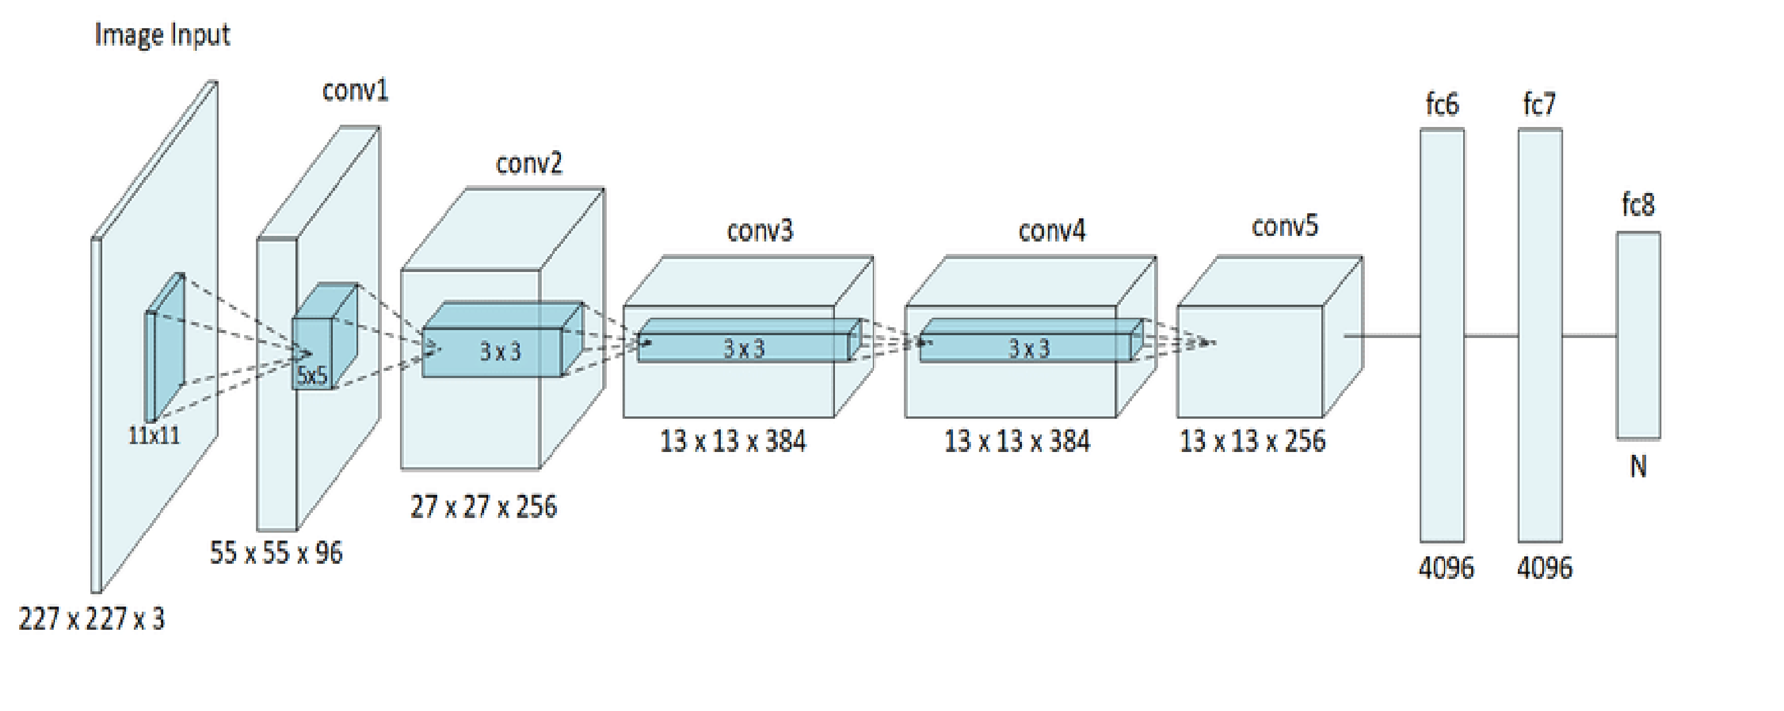
AlexNet

Slide 14
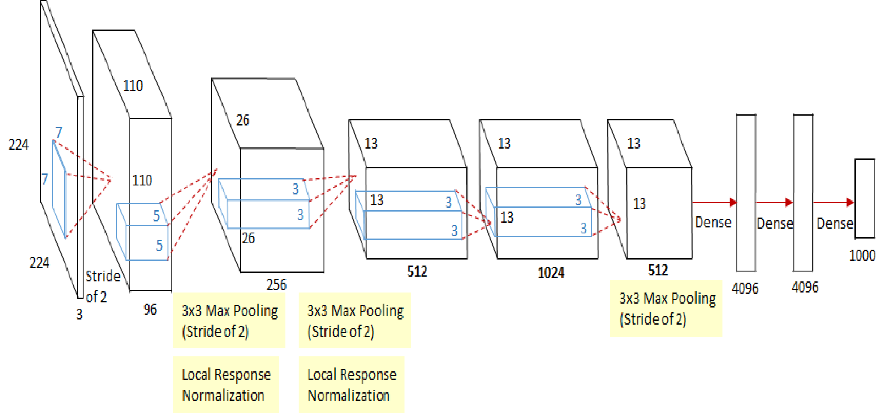
ZfNet

Slide 15
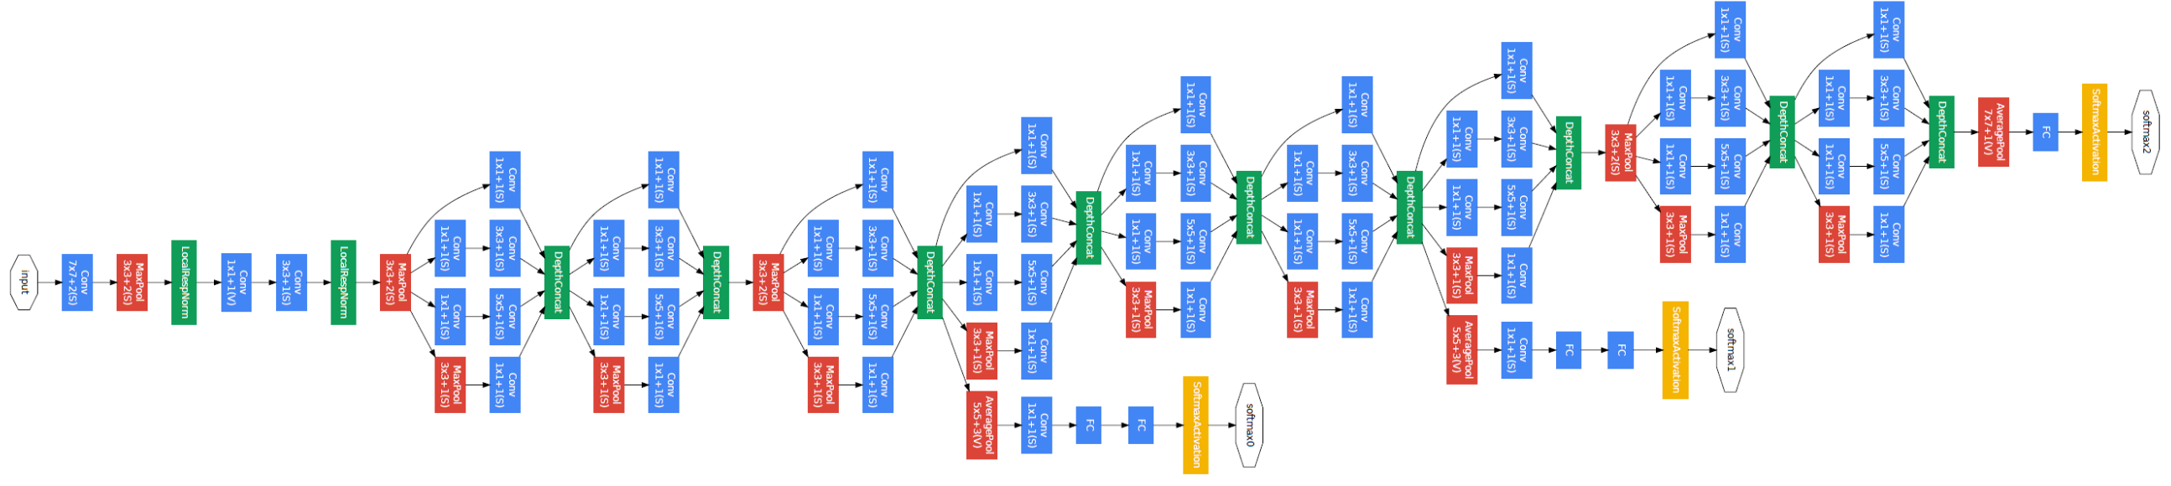
GoogleNet

Slide 16
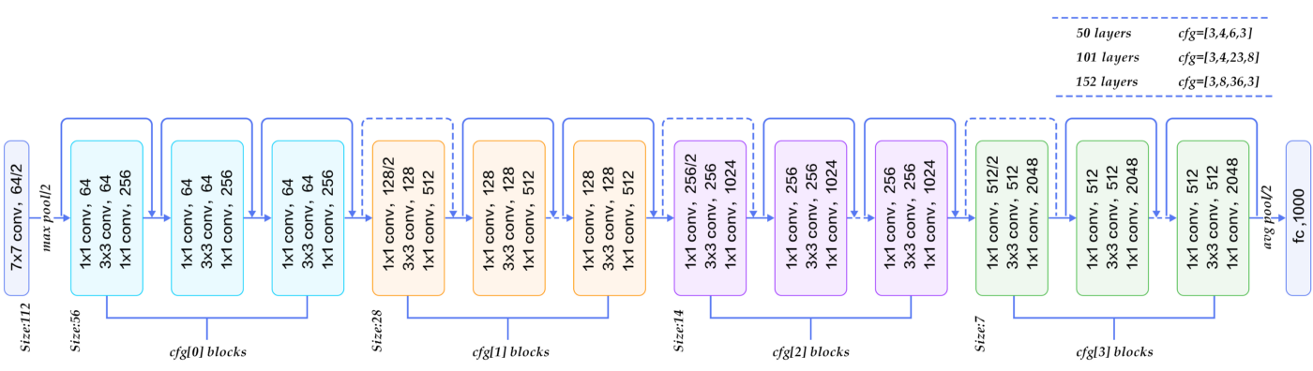
ResNet-50

Slide 17
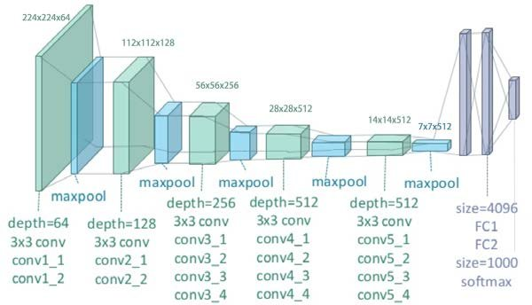
VGG-19

Slide 18
STEP 4
FITTING THE MODEL WITH DATASET
Model Name | Optimizer | Epochs | Loss | Metrics
AlexNet | Adam | 32 | Categorical CrossEntropy | accuracy
ZfNet | Stochastic Gradient Descent (learning rate = 0.1) | 32 | Categorical CrossEntropy | accuracy
GoogleNet | Stochastic Gradient Descent (learning rate = 0.01) | 20 | Categorical CrossEntropy | accuracy
ResNet-50 | Stochastic Gradient Descent (learning rate = 0.01) | 20 | Categorical CrossEntropy | accuracy
VGG-19 | Stochastic Gradient Descent (learning rate = 0.01) | 32 | Categorical CrossEntropy | accuracy

Slide 19
STEP 5
EVALUATNG THE MODEL
Model Name | Training Loss | Training Val Loss | Training Accuracy | Training Val Accuracy | Testing Accuracy
AlexNet | .6932 | .6899 | 50.40% | .7333 | 73.33%
ZfNet | .2127 | .1194 | 92.96 | .9509 | 95.05
GoogleNet | .0213 | .0213 | 99.26 | .9912 | 99.12
ResNet-50 | .0494 | .0962 | 98.13 | .9967 | 96.67
VGG-19 | .1442 | .1171 | 95.51 | .9551 | 95.51

Slide 20
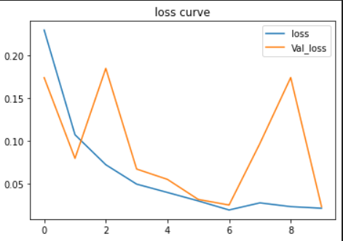
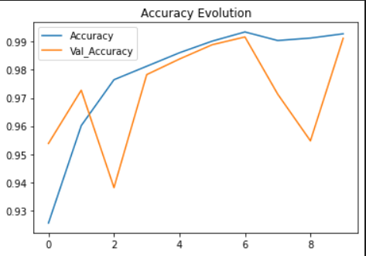
STEP 6
RESULT ANALYSIS
ACCURACY AND LOSS CURVE OF GOOGLENET
TRANSFER LEARNING WITH THE BEST MODEL

Slide 21
FUTURE WORK
Build a model with multi class classification to distinguish between Normal, variants of pneumonia and Covid-19.
Combine CNN models with other classifiers such as Support Vector Machines.
Tune Parameters such as Learning Rate, Batch Size, Optimizers, Number of Layers, Types of Layers, Number of Neurons in each layer, types of activation Function of each layer. Grid Search CV or Randomized Search CV can also be used.

Slide 22
In this project, an automated analysis of classification was achieved using Deep Learning-based approaches. The model had high accuracy regarding the identification of Covid-19 and Normal subjects. The result of high performance of the GoogleNet model make it a useful tool to screen Covid-19 cases. Its promising results indicates that this model can be helpful for medical professionals globally. The research potential of this study is of significant interest as we are still living in the pandemic scenario and new variants of Covid-19 are emerging as substantial threat of infectious virulence.
Should we have automated detection techniques available and health professional get the information in a timely manner, the diagnosis and the management of Covid-19 will be more efficient.

Slide 23


